Slide 1
Multiplexer and Demultiplexer

Slide 2
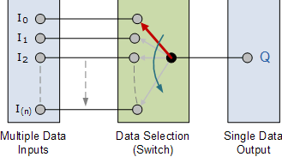
Multiplexer (MUX)
Multiplexing is the generic term used to describe the operation of sending one or more analogue or digital signals over a common transmission line at different times or speeds and as such, the device we use to do just that is called a Multiplexer.

Slide 3
Contin..
A Multiplexer is a combinational circuit that receives binary information from one of 2^{n} input lines and directs it to a single output line.
The selection of a particular input data for the output is determined by a set of selection inputs.
For 2^{n} - to – 1 multiplexer has 2^{n} inputs and n selection inputs.

Slide 4
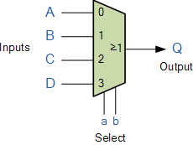
The multiplexer symbol is
For example, 4 – to – 1 multiplexer,
4 - inputs 2 – selection inputs

Slide 5
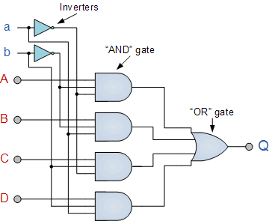
Logic circuit for 4- to – 1 multiplexer

Slide 6

Truth table
input select input output
A 0 0 A
B 0 1 B
C 1 0 C
D 1 1 D

Slide 7
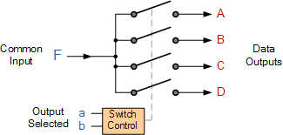
Demultiplexer (Demux)
The exact opposite of the Multiplexer.
The demultiplexer takes one single input data line and then switches it to any one of a number of individual output lines one at a time.
The demultiplexer converts a serial data signal at the input to a parallel data at its output lines as shown below.

Slide 8
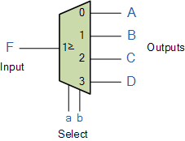
Symbol of demultiplexer
Selected Inputs |  | Data Output selected
a | b
0 | 0 | A
0 | 1 | B
1 | 0 | C
1 | 1 | D

Slide 9
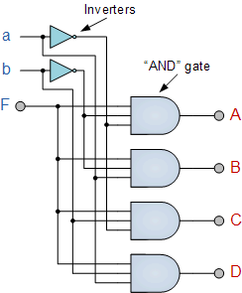

Logic circuit

